Slide 1

WeCare Indoor Positioning Module
Prepared by: Ong Jia Aun
Supervised by: Dr. Zati HAKIM BINTI AZIZUL HASAn

Slide 2

Our Collaborator
Specialises in:
IoT smart devices
RFID technologies

Slide 3
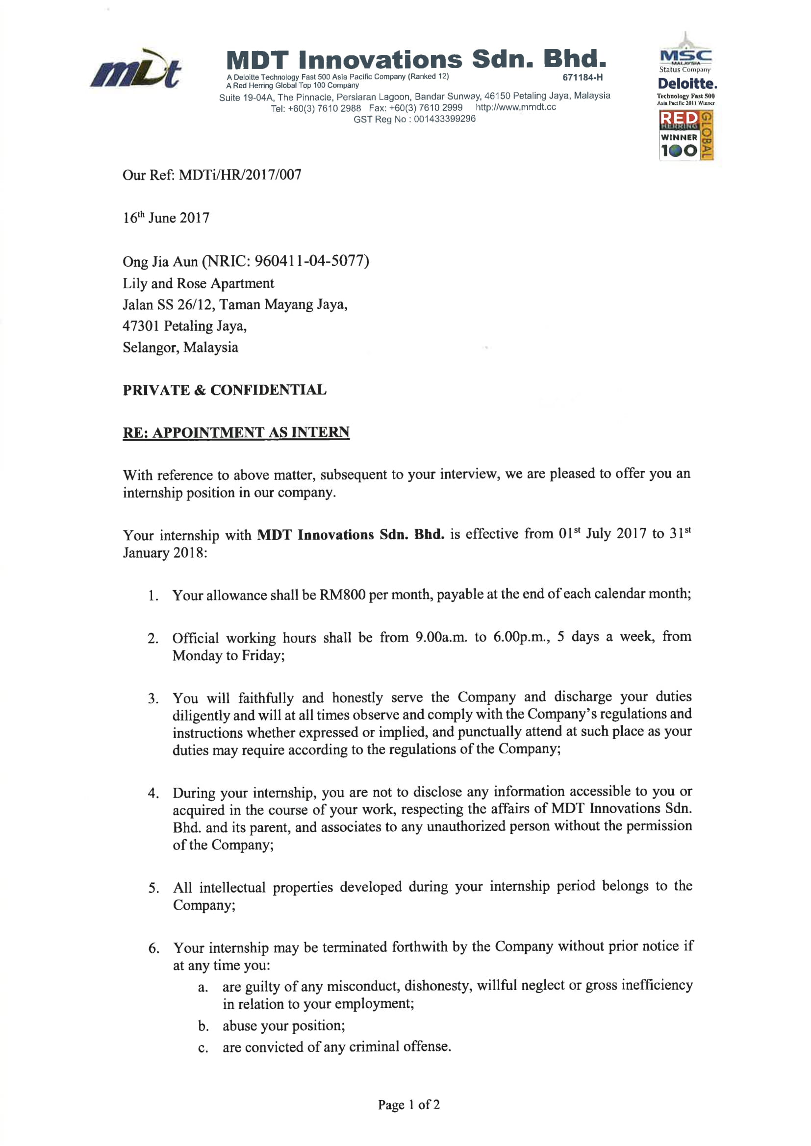
Collaboration
Internship at the company at Session 2017/2018 Semester I

Slide 4
Introduction
According to Census of Fatal Occupational Injuries (CFOI), the construction industry ranked fourth in highest fatal injury rates among all industry.
And yet contractors, especially here in Malaysia, lack of any appropriate approach to comply with the Occupational Safety and Health Administration (OSHA) standard to ensure their workers’ safety in the site.
WeCare provides the solution for an organization to monitor the safety of its members/users by keeping track of their real-time health status and location via wearable. It aims to be a cost-effective and robust system that support multiple language.

Slide 5
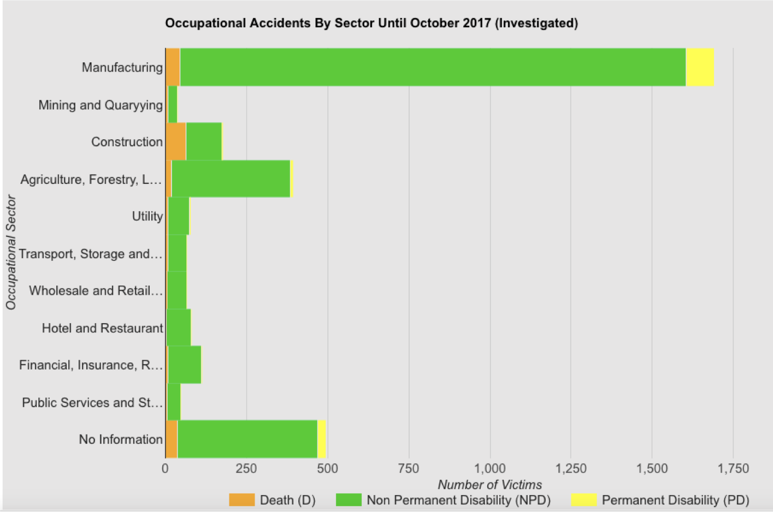
Source: Department of Occupational Safety and Health Malaysia

Slide 6
Problem Statement
Unable to monitor workers’ health status and location in real-time.
Manual logging of workers’ data
No two-way communication between site supervisors and outdoor workers.

Slide 7
Project Objectives
To monitor heart conditions and track the locations of outdoor workers in real time.
To enable two-way communication between site supervisors and workers.

Slide 8
Project Functional Hierarchy Diagram
WeCare
MDT Innovations
Indoor Positioning
Backend System
Mobile Application
Admin Web Application
Ong Jia Aun
Ong Seow Sze
Wang Zhong Qi
Teoh Khau Kheng

Slide 9
Module Problem Statement
The only ready-to-use data for positioning is GPS.
Unable to sole rely on GPS for positioning, especially in indoor environment.

Slide 10
Module user Requirements
Able to provide a good enough positioning data in indoor environment
Able to provide more than one way for positioning at outdoor environment

Slide 11
Module Objectives
Produce a working indoor positioning solution based on data received from device
Switch between using GPS and developed indoor positioning solution automatically at outdoor and indoor

Slide 12
Literature Review
Research Questions | Review and Summary | References
How reliable GPS is in indoor environment? | Unable to properly lock on GPS satellites or take too long to do so. | [1], [2]
Is positioning using LBS feasible in indoor environment? | Yes, it has been implemented before, although the accuracy is at best 50m. | [2], [3]
Is positioning using just WiFi RSSI possible? | Inexpensive solution, but require a known database of WiFi access points. | [1], [4]

Slide 13
REFERENCES
[1]
Liu, H., Darabi, H., Banerjee, P., & Liu, J. (2007). Survey of wireless indoor positioning techniques and systems. IEEE Transactions on Systems, Man, and Cybernetics, Part C (Applications and Reviews), 37(6), 1067-1080.
Dedes, G., & Dempster, A. G. (2005, September). Indoor GPS positioning-challenges and opportunities. In Vehicular Technology Conference, 2005. VTC-2005-Fall. 2005 IEEE 62nd (Vol. 1, pp. 412-415). IEEE.
Yang, J., Varshavsky, A., Liu, H., Chen, Y., & Gruteser, M. (2010, September). Accuracy characterization of cell tower localization. In Proceedings of the 12th ACM international conference on Ubiquitous computing (pp. 223-226). ACM.
Gu, Y., Lo, A., & Niemegeers, I. (2009). A survey of indoor positioning systems for wireless personal networks. IEEE Communications surveys & tutorials, 11(1), 13-32.
[2]
[3]
[4]

Slide 14




Module top view
Worker/User
(with wearable)
Analyse Data
(Trilateration with Cell Tower Information and WiFi)
Web Server
Database

Slide 15
Module FLOW
Data packet
Cell Tower Details
WiFi SSID + RSSI
Heartrate
Processed Data
Data
User Device
Server Backend
Server Database
Web / Mobile Application
Raw Data
Processed Data
Triangulation Algorithm

Slide 16
Raw data packet
[3G*15052018*00E6*UD2,170118,030135,V,22.570675,N,113.8621067,E,0.00,0.0,0.0,0,82,22,0,0,00000010,1,255,502,16,21091,25021,137,3,mdtresearch@unifibiz,6c:72:20:3d:28:54,-64,GWNET,1c:1d:86:41:11:81,-90,Sunway Pinnacle_Guest,1c:1d:86:41:11:83,-93,12.7]
GPS
Cell tower
WiFi

Slide 17
Work done : implementing the trilateration calculation
Trilateration
Using GSM/GCDA data
Using WiFi RSSI

Slide 18
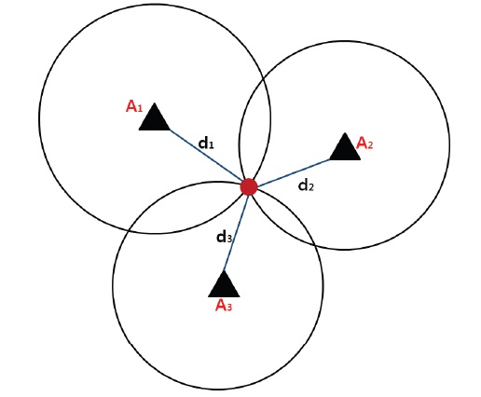
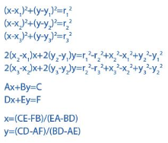
Trilateration

Slide 19
Pseudocode of calculation on database query
Database info
M1 = X1, Y1
M2 = X2,Y2
M3 = X3,Y3
Let input data be [ [ M1, RSSI1 ], [ M2, RSSI2 ], [ M3, RSSI3 ] ]
We calculate the weighted signal for each input data
W1 = RSSI1/ (RSSI1 + RSSI2 + RSSI3)
W2 = RSSI2/ (RSSI1 + RSSI2 + RSSI3)
W3 = RSSI3/ (RSSI1 + RSSI2 + RSSI3)
X = W1*X1 + W2*X2 + W3*X3
Y = W1*Y1 + W2*Y2 + W3*Y3

Slide 20
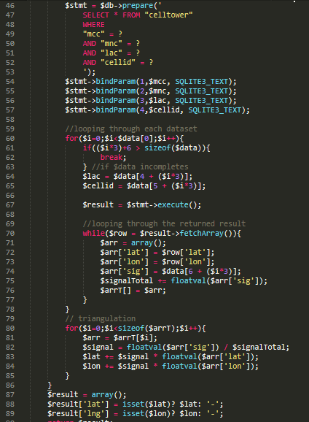
Translation to php codes

Slide 21
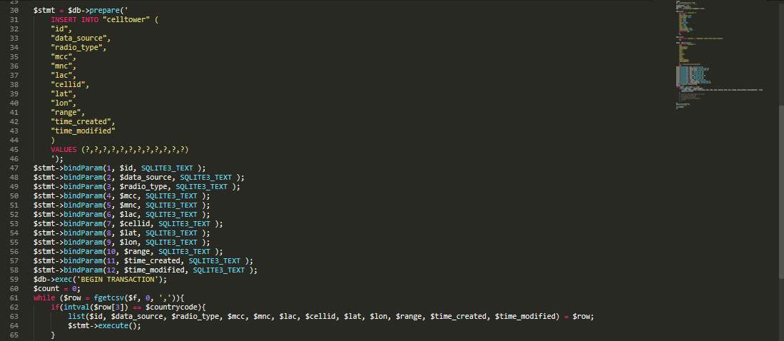
WORK DONE: Generate Database from online sources
Extract data from .csv file and generate SQLite database for faster querying.

Slide 22
Code demo

Slide 23
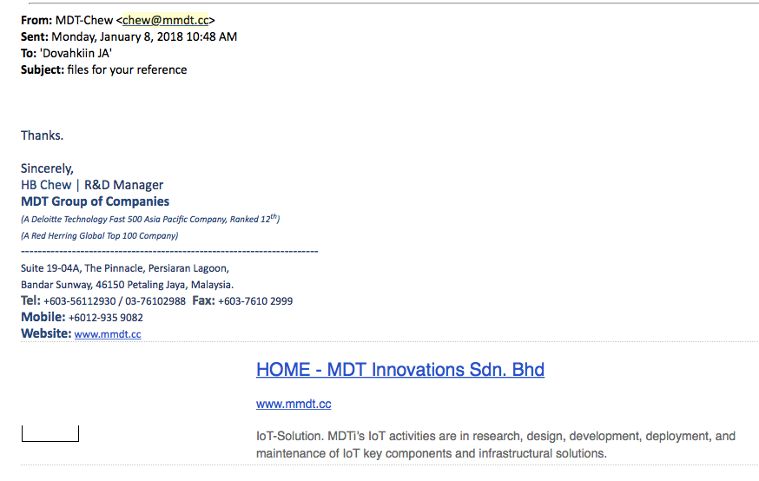
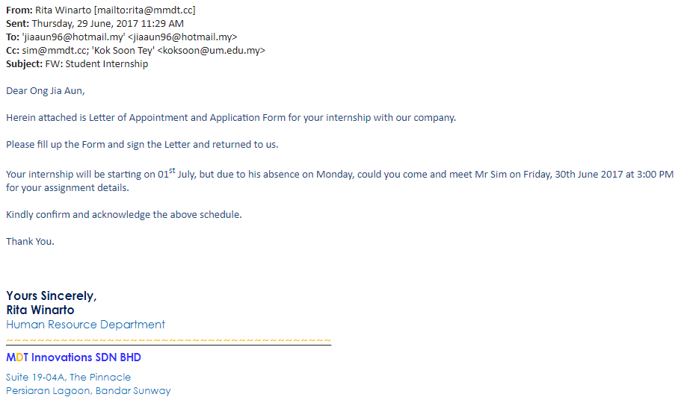
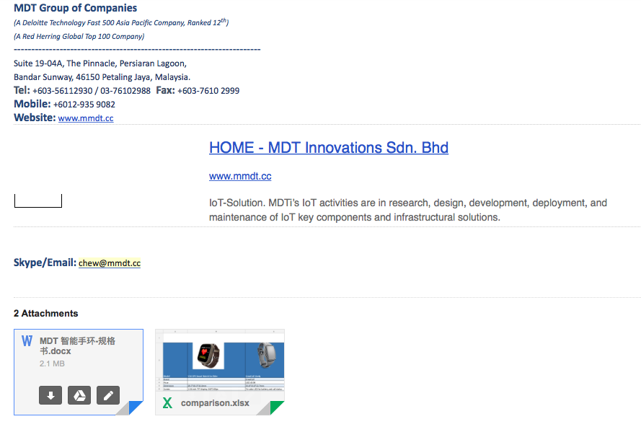
Stakeholder initiatives

Slide 24
Q & A

